Slide 1
3. Data Exploration

Slide 2
Objectives of Data Exploration
Understanding data
Data preparation
Data mining tasks
Interpreting data mining results

Slide 3
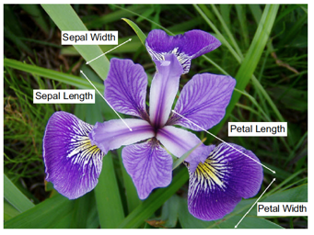
Data Sets
1http://commons.wikimedia.org/wiki/File:Iris_versicolor_3.jpg#mediaviewer/File:Iris_versicolor_3.jpg

Slide 4
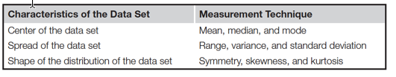
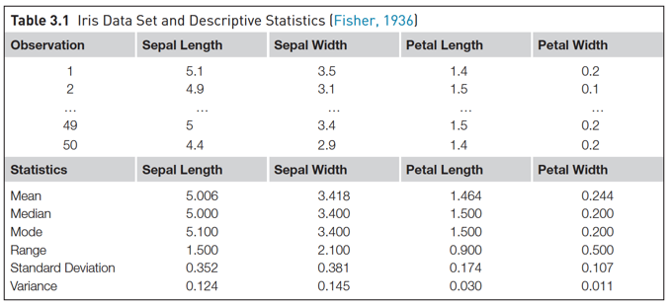
Descriptive Statistics - Univariate

Slide 5
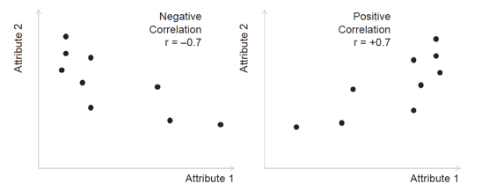
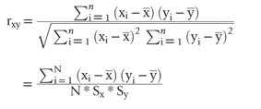
Descriptive Statistics - Multivariate
Central datapoint
Correlation

Slide 6
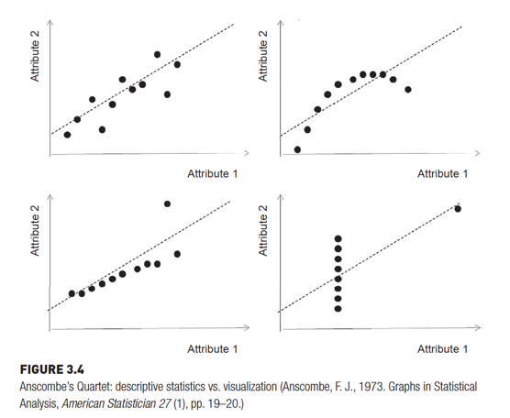
Descriptive Statistics - Multivariate

Slide 7
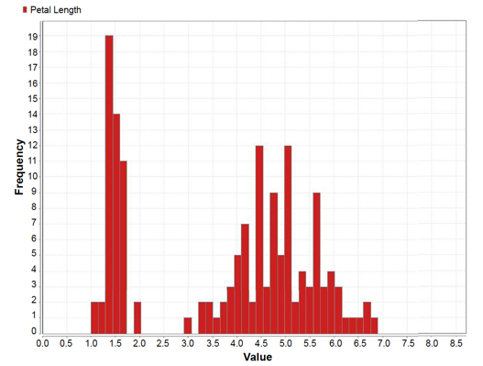
Data Visualization
Histogram

Slide 8
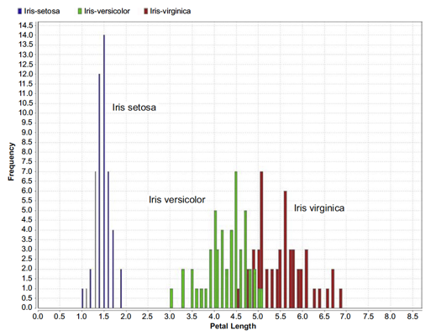
Data Visualization
Class stratified Histogram

Slide 9
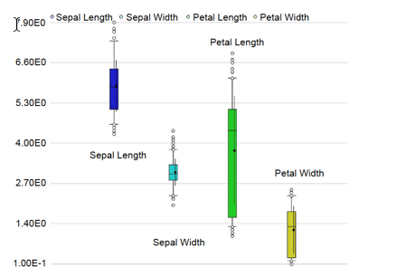
Data Visualization
Quantile plot

Slide 10
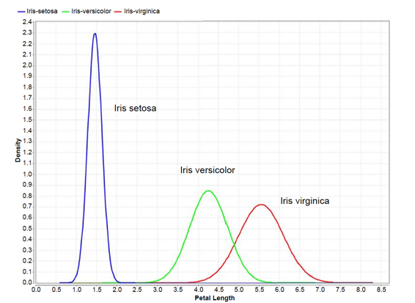
Data Visualization
Distribution plot

Slide 11
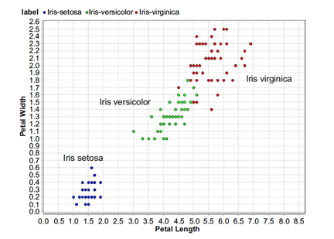
Data Visualization
Scatter plot

Slide 12
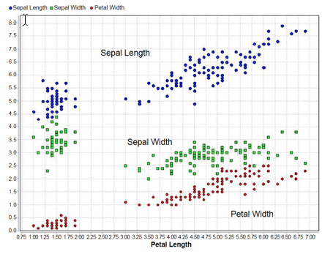
Data Visualization
Scatter mutiple

Slide 13
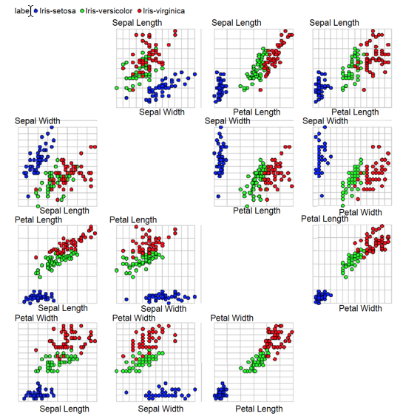
Data Visualization
Multiple Scatter matrix

Slide 14
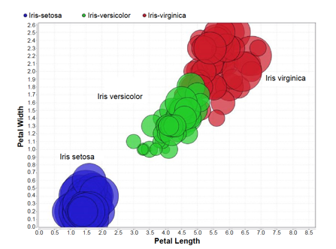
Data Visualization
Bubble plot

Slide 15
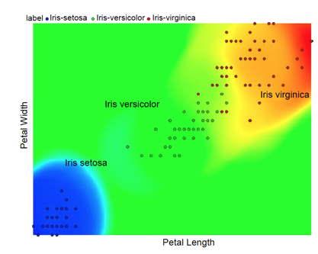
Data Visualization
Density chart

Slide 16
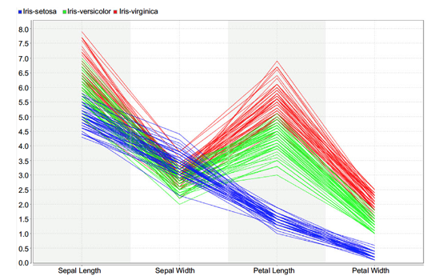
Data Visualization
Parallel chart

Slide 17
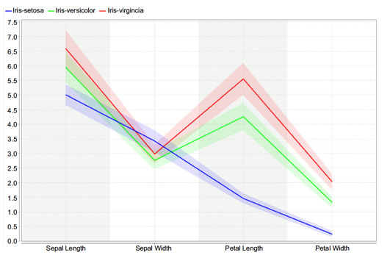
Data Visualization
Deviation chart

Slide 18
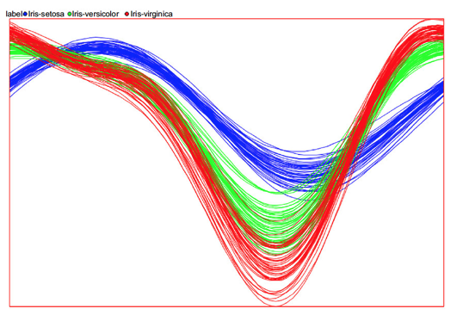
Data Visualization
Andrews curves

Slide 19
Roadmap for data exploration
1. Organize the data set
2. Find the central point for each attribute:
3. Understand the spread of the attributes:
4. Visualize the distribution of each attributes:
5. Pivot the data:
6. Watch out for outliers:
7. Understanding the relationship between attributes:
8. Visualize the relationship between attributes:
9. Visualization high dimensional data sets:
Kotu, V., & Deshpande, B. (2014). Predictive analytics and data mining: concepts and practice with rapidminer. Morgan Kaufmann.

Slide 20
Data Visualization
Parallel chart

